Slide 1
Forest Fires: Economic and Political Consequences
By Adam Vandenbroek

Slide 2

Economic Consequences of Forest Fires
Forest fires have a big impact on a country’s economy.
It costs a lot of money to fight a forest fire and recover from it.
Forest fires cause some people to lose their jobs, and other people to find new work.

Slide 3

Putting Out Forest Fires Is Expensive
It costs thousands or millions of dollars to put out a forest fire. The expenses include:
Airplanes and helicopters that drop water and foam on fires.
Reconnaissance aircraft that track the progress of fires.
Fire trucks and water tenders.
Communication equipment.
Salaries of fire fighters and other people on the team.

Slide 4

Double Trouble Fire
In 2002 in New Jersey, someone lit an illegal camp fire in Double Trouble State Park. It got out of control and turned into a forest fire.
It cost $120,000 to put out the fire.

Slide 5

Colorado Fire
In 2002 in Colorado, an arsonist started a fire that lasted 25 days and burned 56,000 hectares of forest.
The arsonist was a forestry technician. She went to jail.
It cost $39 million to put out the fire.

Slide 6

Black Saturday Bushfires
In 2009 in Victoria, Australia, the Black Saturday bushfires cost $593 million to put out.

Slide 7
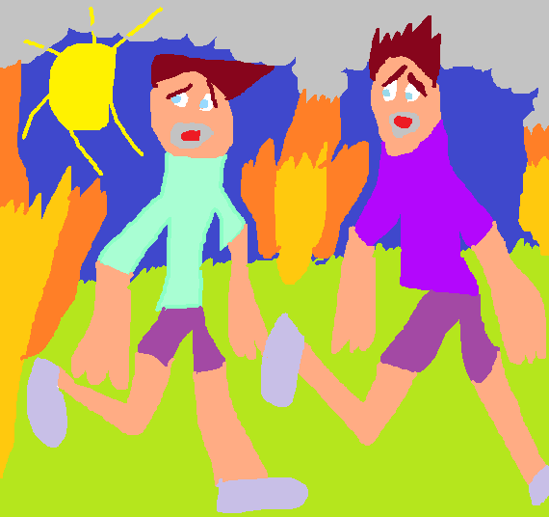
Evacuation
When a forest fire is burning, people in danger have to get away fast. It costs money for cars, buses, planes, etc. to move them.
Then they need to live in temporary housing. This can cost money too.
Sometimes they move too far from their jobs to work, so they lose their pay.
38,000 people had to be evacuated in the fire in Colorado.
About 8,000 people were evacuated in the Black Saturday bushfires.

Slide 8

Property
Forest fires often destroy property such as houses, businesses and vehicles.
The Black Saturday bushfires destroyed more than $1.2 billion worth of houses, businesses and vehicles.
The Black Saturday fires also killed 11,800 farm animals (sheep, cattle, horses). 200,000 kilograms of trout died in fish farms.

Slide 9
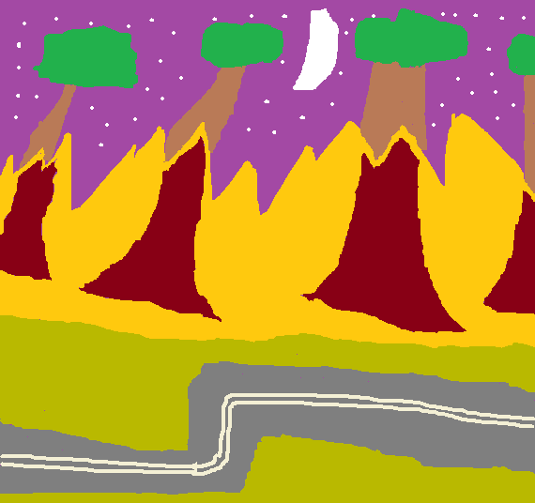
Roads
Forest fires often impact roads that go through them or near them.
Damaged roads require expensive repairs.
While roads are unavailable, the economy suffers when people can’t get to work or make deliveries as quickly as usual.

Slide 10

Power
Sometimes forest fires harm a region’s power supply by damaging wires and other equipment.
The Black Saturday bushfires damaged $729,000 worth of electrical equipment.

Slide 11
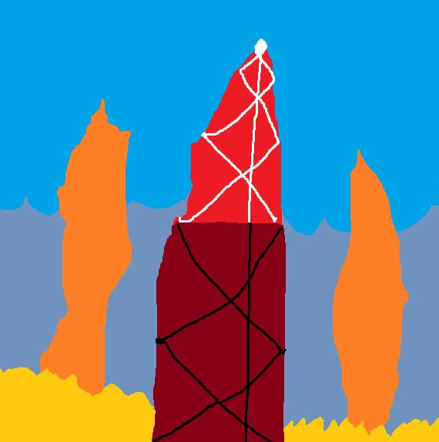
Telecommunications
Telecommunications equipment is sometimes damaged in a forest fire.
In the Black Saturday bushfires, the Telstra telecommunications company lost $20 million.

Slide 12

Water Supply
Forest fires can wreak havoc on a region’s water supply.
The fire in Colorado damaged the city of Denver’s water reservoir, and cost $4 million to repair.
The Black Saturday fires burned water catchment areas around the city of Melbourne, causing $5 million of destruction to the city’s water supply.

Slide 13
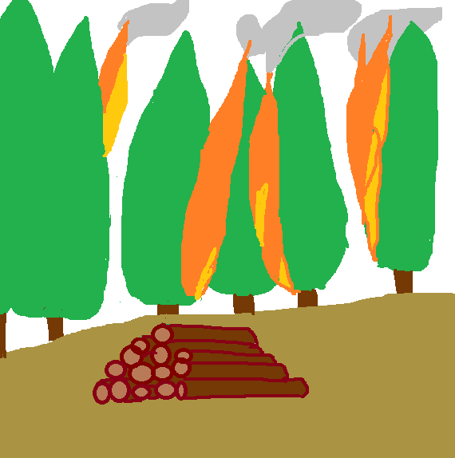
Timber
Sometimes forest fires destroy trees that people had planned to cut down for timber.
In 2002 in Arizona, a fire burned more than $300 million worth of timber.
In the Black Saturday fires, about $600 million worth of timber was lost.

Slide 14

Tourism
Some forest fires hurt tourism when they burn popular vacation places, such as campsites in parks.
In 2000 in Montana, a wildfire damaged historic sites in the Helena National Forest. A lot of tourists stopped visiting.
After the Black Saturday fires, fewer tourists went to the Vara Valley, a wine-making area.

Slide 15

Recovering From Forest Fires
After a forest fire has been put out, large sums of money are spent to recover.
After the Black Saturday fires, $1.1 billion were spent to replant forests, fix infrastructure and rebuild communities.
These recovery activities provide jobs and pump up the economy.

Slide 16

Health Care
People injured in a fire often require expensive treatment.
When they’re not well enough to work, they lose wages.
In 2001 a fire burned 116,000 hectares of forest near Chisholm, Alberta. Its health-related costs were about $9 million.
The Black Saturday fires injured many people and had high health costs.

Slide 17

Figuring Out What Went Wrong
Sometimes money is spent to figure out the causes of forest fires and how to prevent and better fight them.
After the Black Saturday fires, a Royal Commission and other groups spent $90 million investigating the fires and writing recommendations for the future.

Slide 18

Who Pays For All This?
Taxpayers: the government collects taxes from citizens, and uses the money to fight fires and restore damaged infrastructure.
Insurance companies: people buy insurance for houses, businesses and other properties. The insurance companies pay for damages.
Donors: people who want to help donate money and time.
People sometimes have to use their own money to restore what they have lost.

Slide 19

Political Consequences of Forest Fires
Forest fires sometimes have an impact on the government.
The 2009 Victoria Bushfires Royal Commission came up with 52 recommendations. The governments of Australia and the state of Victoria are expected to do a lot of work to carry out the recommendations.

Slide 20

Political Consequences, Indonesian Fires
Indonesia frequently has fires that destroy precious old-growth forests. Some people there start illegal fires to clear land so they can grow crops.
Indonesian citizens and newspapers criticize the Indonesian government, saying it doesn’t do anything to stop the fires.

Slide 21
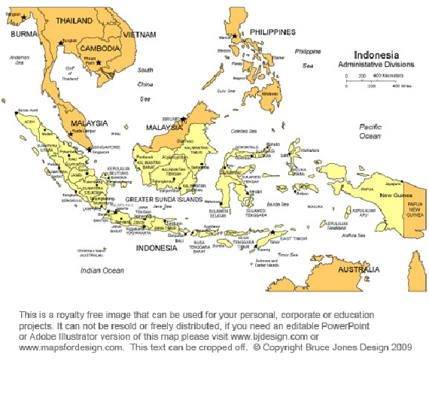
Political Consequences, Indonesian Fires
The smoke from Indonesian forest fires blows over to the nearby countries of Singapore, Malaysia and Thailand.
The smoke causes terrible air pollution. In Singapore it’s so bad some people wear masks.
The governments of Singapore, Malaysia and Thailand blame Indonesia for the fires. Indonesia says some of the fires are caused by bad people from Singapore, Malaysia and Thailand who want to set up plantations.

Slide 22

Political Consequences, Indonesian Fires
Some environmentalists criticize foreign governments all over the world for not helping Indonesia to stop having forest fires.
They say foreign governments should send experts there to help Indonesia protect its forests.
They say Indonesia’s forests guard against global warming and have many diverse animals and plants, so the whole world should want to protect them.

